Slide 1

Quicksort using divide and conquer algorithm
Name: Shahd Ali Elganaini
ID:224217

Slide 2

THE STRATEGY
Agenda
1
PROBLEM
2
THE ALGORITHM
3
THE IMPLEMENTATION
4
THE ANALYSIS
5

Slide 3


Divide and conquer Algorithm:
Divide and Conquer is a powerful algorithmic technique that involves breaking down a problem into smaller subproblems, solving them independently, and then combining their solutions to solve the original problem. The basic idea is to divide a problem into smaller, more manageable parts, solve those parts, and then combine the solutions to get the final result.
The Divide and Conquer algorithm typically follows three steps:
1-Divide: Break the problem into smaller subproblems that are similar to the original problem. This step continues until the subproblems become simple enough to solve directly.
2-Conquer: Solve the subproblems. If the subproblems are small enough, solve them directly. Otherwise, recursively apply the Divide and Conquer algorithm to further break them down.
3-Combine: Combine the solutions of the subproblems to get the solution for the original problem.

Slide 4



PROBLEM OF SIZE N
subproblem 1
of size n/2
subproblem 2
of size n/2
solution to
subproblem 1
solution to
subproblem 1
solution to
the original problem

Slide 5

What is quicksort?
Quicksort is a sorting algorithm that follows the Divide and Conquer paradigm. It was developed by Tony Hoare in 1960 and is widely used for its efficiency and performance. Quicksort operates by partitioning an array into smaller subarrays, sorting those subarrays independently, and then combining them to achieve the final sorted array.

Slide 6



Example of quicksort implementation:
s
e
index
0
1
2
3
4
2
5
3
1
4
array not sorted
M=s+e/2
In this example, the center number equals 2,
so the pivot number = 3

Slide 7
Continue to solve the example
m
index
0
1
2
3
4
r
l
2
5
3
1
4
array not sorted
Provided that it
is greater than
or equal to the
pivot number
pivot
Provided that
it is less than or equal
to the pivot number

Slide 8


m
0
1
2
3
4
r
l
2
5
3
1
4
2
5
1
4
l
r
1
5
2
1
3
5
4

Slide 9

the final sorted array
l
r
2
1
3
5
4
index
0
1
2
3
4
2
1
3
5
4
array not sorted
1
2
3
5
4
1
2
3
4
5
1
2
3
4
5

Slide 10


Slide 11
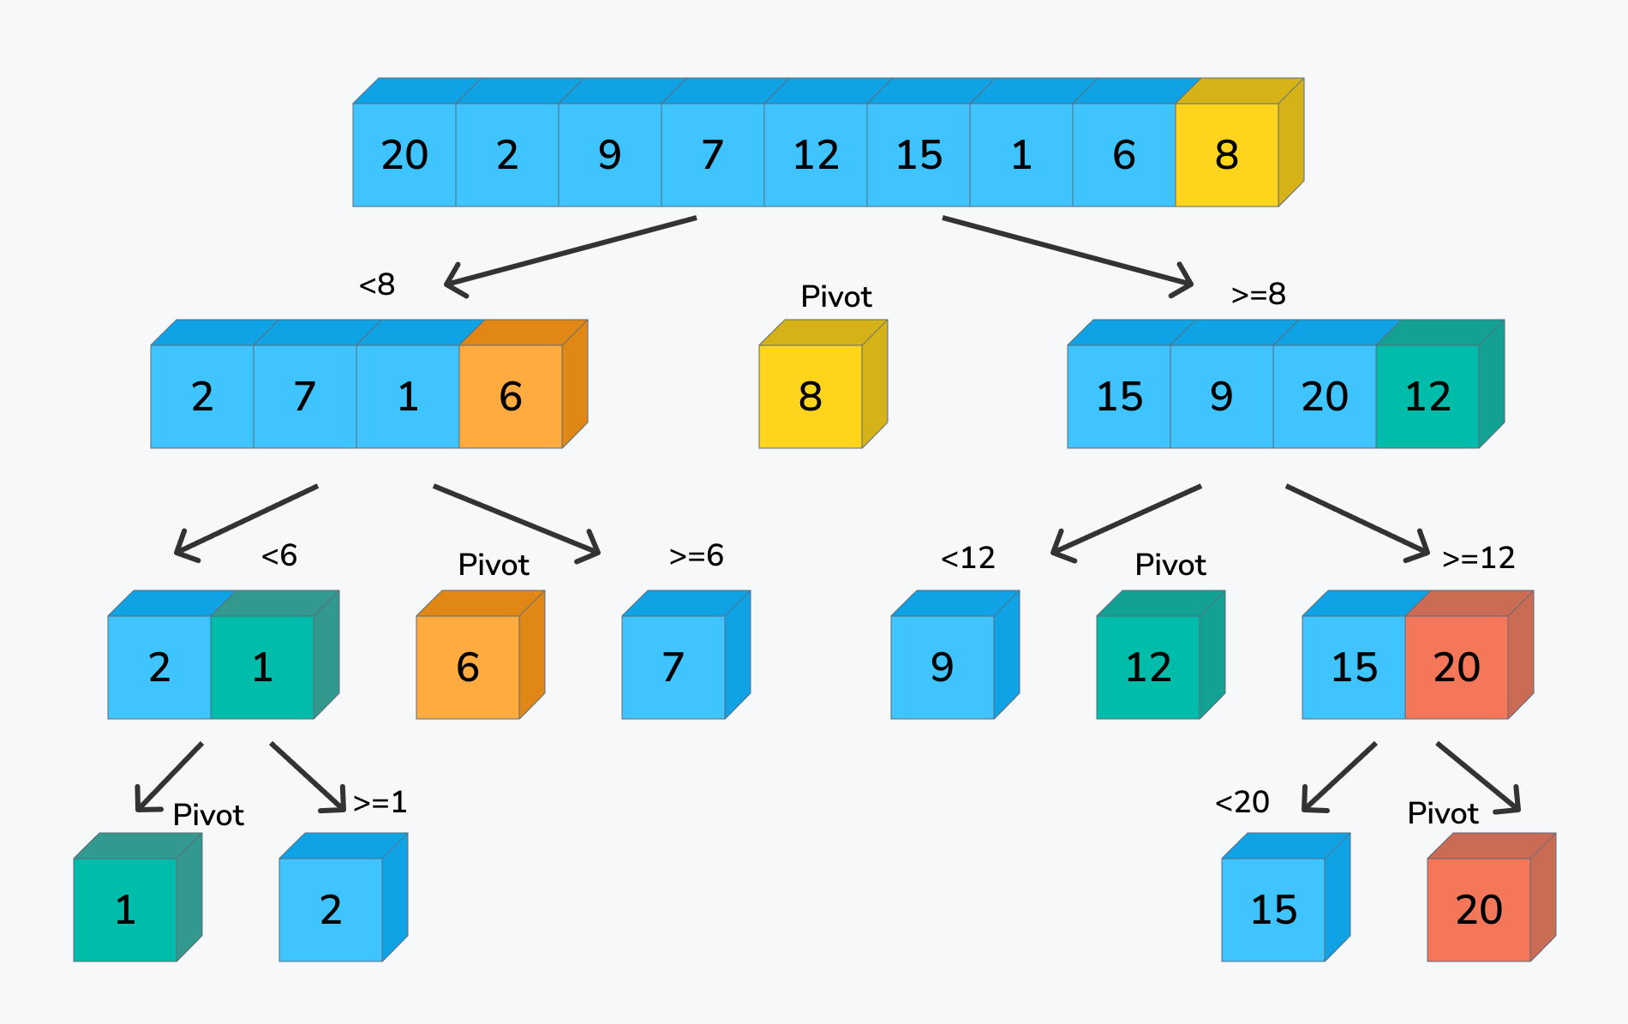

Slide 12


quicksort algorithm
def quicksort(arr):
if len(arr) <= 1:
return arr
else:
pivot = arr[-1] # Choose the last element as the pivot
less = [x for x in arr[:-1] if x <= pivot]
greater = [x for x in arr[:-1] if x > pivot]
return quicksort(less) + [pivot] + quicksort(greater)
# Example usage:
my_array = [3, 1, 4, 1, 5, 9, 2, 6, 5, 3, 5]
sorted_array = quicksort(my_array)
print(sorted_array)

Slide 13
algorithm quicksort(python language)
def quicksort(arr):
if len(arr) <= 1:
return arr
pivot = arr[len(arr) //2]#choose the middle element as the pivot
left= [x for x in arr if x<pivot]
middle =[x for x in arr if x==pivot]
right=[x for x in arr if x>pivot]
return quicksort(left)+middle +quicksort(right)
# Example usage
arr=[20,2,7,12,15,1,6,8]
sorted_arr = quick_sort(arr)
#print("sorted array",sorted_arr)

Slide 14
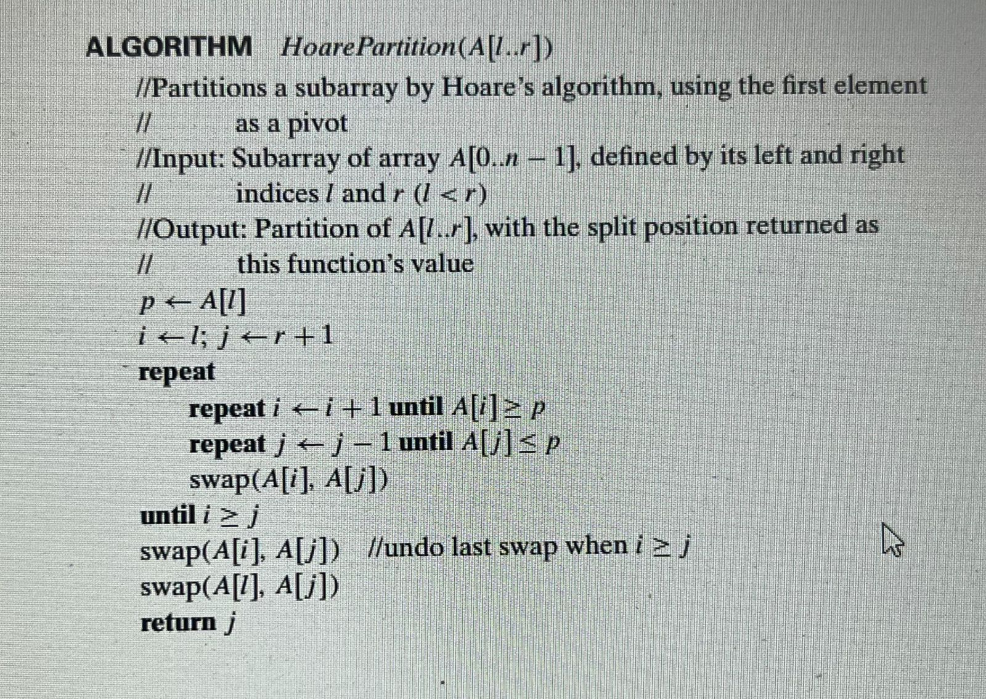

Slide 15

Analysis of Quicksort
T(n)=2(2T(n/4)+(n/2)
T(n/4)2T(n/8)+(n/4)
T(n)=2T(n/2)+(n)
T(n)=2(2T)(n/4)+n/2)+n
T(n)=4T(n/4)+2n+n
T(n)=4(2T)(n/8)+(n/4)+2n+n
#T(n)=8T(n/8)+4n+2n+n
##T(n)=2^kT(n/2^k)+kn
T(n)=2^kT(n/2^k)+kn
#n/2^k=1
Reaching the best case
this
pattern

Slide 16


Best case: split in the middle — Θ(n log n)
Worst case: sorted array! — Θ(n2)
Average case: random arrays — Θ(n log n)
Analysis of
Quicksort

Slide 17
Analysis of Quicksort
Best Case:
The best case for Quicksort occurs when the pivot selected in each partitioning step consistently divides the array into two nearly equal halves.
In the best-case scenario, the time complexity is O(n log n), where n is the number of elements in the array.
This typically happens when the pivot is chosen in such a way that it is the median of the elements.
Average Case:
The average case for Quicksort assumes a random distribution of data and random pivot selection.
On average, Quicksort exhibits a time complexity of O(n log n).
The random pivot selection helps achieve balanced partitions, leading to efficient sorting.
Worst Case:
The worst case for Quicksort occurs when the pivot selection consistently results in highly unbalanced partitions.
The worst-case time complexity is O(n^2), which happens when the pivot is always the smallest or largest element.
This worst-case behavior can be mitigated by using strategies like random pivot selection or the "median of three" method, where the median of the first, middle, and last elements is chosen as the pivot.

Slide 18
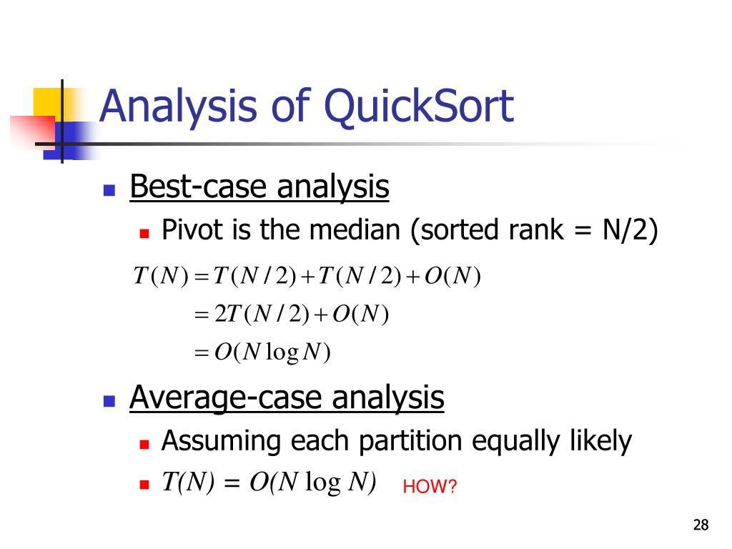

Slide 19


conclusion
Quicksort stands out as a highly efficient sorting algorithm. Its Divide and Conquer strategy, coupled with in-place sorting, makes it versatile for diverse datasets. While the worst-case time complexity is O(n^2), careful pivot selection mitigates this. Quicksort's adaptability, average-case performance of O(n log n), and potential for parallelization contribute to its widespread use. Understanding its strengths and strategies for optimization allows us to leverage Quicksort effectively in various practical applications.

Slide 20
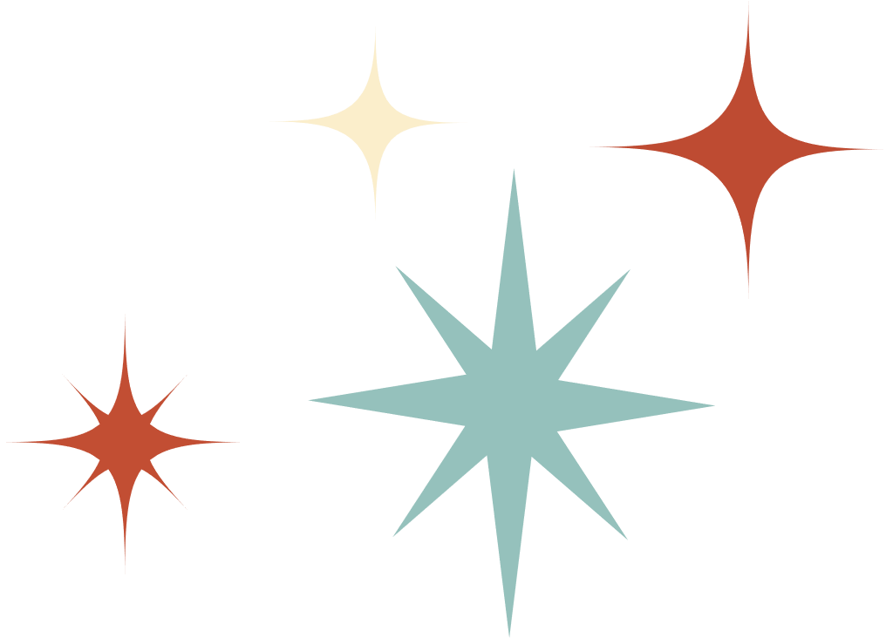
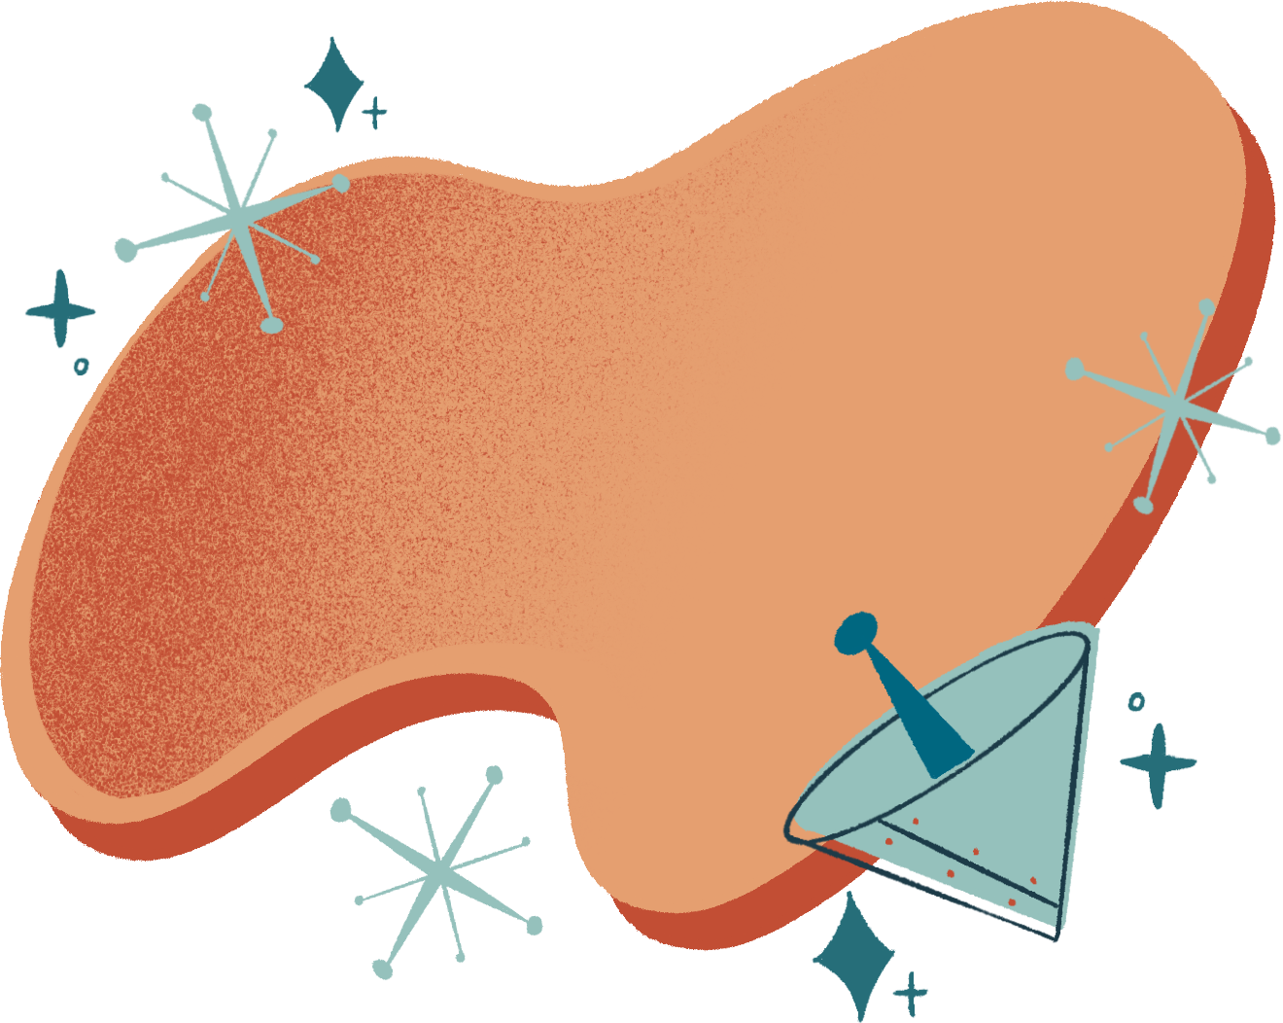



Thank
YOU

